Slide 1

TRAIN MANAGEMENT SYSTEM
SUBMITTED BY
ADARSH DWIVEDI
SQL & POWERBI
PROJECT

Slide 2

overview
Addressing Complexity:
"The Indian Railways deals with tons of data. This project uses a computer database to organize it all.”
Centralized Solution:
"Instead of having information scattered everywhere, this system stores it all in one central database.“
Enhanced Efficiency:
"This system helps manage things like ticket bookings and train schedules, so the railway works better for everyone."

Slide 3
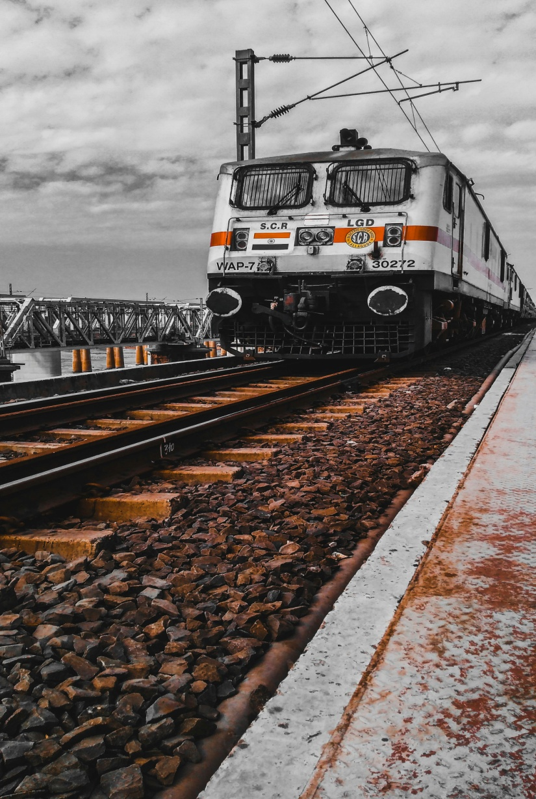
OBJECTIVE
"The primary objective of this project is to develop a MySQL-based Indian Railway Management System, aiming to create a centralized database for efficient storage and retrieval of operational data.
This system will streamline passenger reservation and train scheduling processes, ultimately improving operational efficiency and enhancing the user experience."

Slide 4
DATABASE SCHEMA

Slide 5
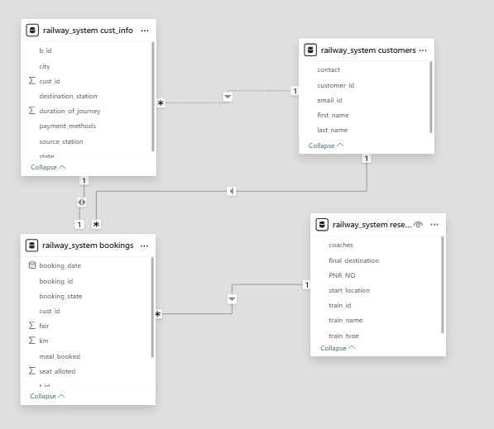

Slide 6
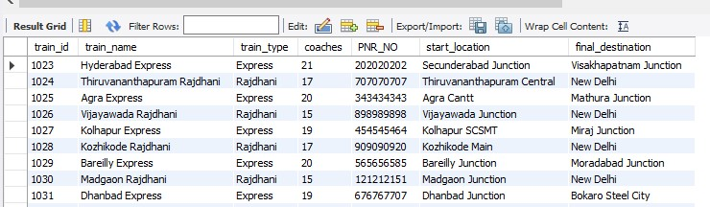
VIEWING TABLES
SELECT * FROM RESERVATION ;

Slide 7
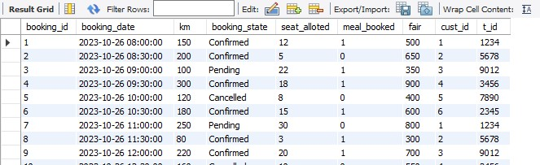
VIEWING TABLES
SELECT * FROM BOOKINGS ;

Slide 8
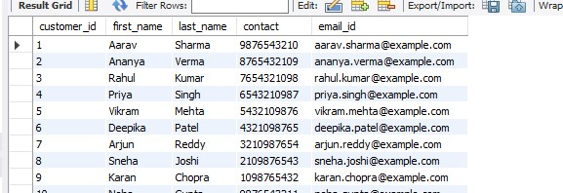
VIEWING TABLES
SELECT * FROM CUSTOMERS ;

Slide 9
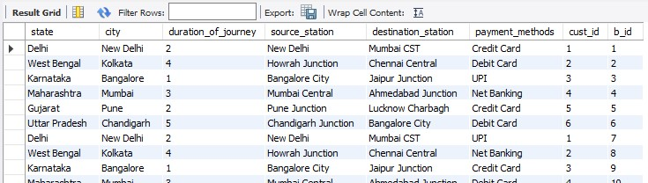
VIEWING TABLES
SELECT * FROM CUST_INFO ;

Slide 10
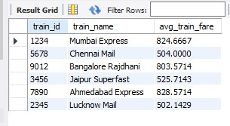
Calculating average fare per train
select train_id , train_name, avg(fair) as avg_train_fare from bookings b inner join reservation r on b.t_id = r.train_id group by 1,2 ;

Slide 11

Finding those trains which has maximum number of confirmed bookings
select train_name , count(*) as counta from reservation r inner join bookings bon r.train_id = b.t_id where booking_state = "confirmed" group by 1 order by counta desc limit 1;

Slide 12
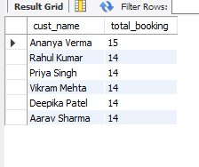
Finding those customers who made multiple bookings
select concat(first_name," " ,last_name) as cust_name , count(*) as total_booking from customers c inner join bookings b on c.customer_id = b.cust_idwhere booking_id >1 group by 1 ;

Slide 13
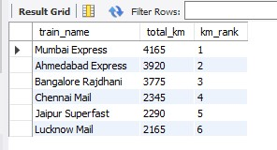
Ranking trains on the total km’s travelled
SELECT train_name, SUM(km) AS total_km, RANK() OVER (ORDER BY SUM(km) DESC) AS km_rankFROM reservation rJOIN bookings b ON r.train_id = b.t_idGROUP BY train_nameORDER BY total_km DESC;

Slide 14
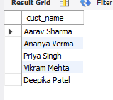
Finding those customers who have booked more than 15 coaches .
SELECT concat(first_name," ", last_name) as cust_nameFROM customersWHERE customer_id IN ( SELECT cust_id FROM bookings WHERE t_id IN ( SELECT train_id FROM reservation WHERE coaches > 15 ));

Slide 15
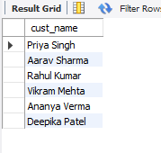
Finding those customers whose booking fare is greater than the average fare .
select concat(first_name," ",last_name) as cust_name from customers cwhere c.customer_id in (select b.cust_id from bookings b where b.fair >(select avg(fair) from bookings));

Slide 16
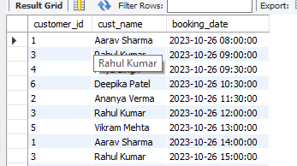
Listing those customers who have booked meal along with their booking date .
select customer_id, concat(first_name," ",last_name) as cust_name ,booking_datefrom customers c inner join bookings bon c.customer_id = b.cust_id where meal_booked is True;

Slide 17
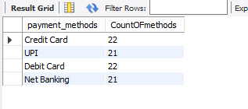
Find the count of each payment methods.
select payment_methods ,count(payment_methods) as CountOFmethods from bookings b inner join cust_info cion b.booking_id = ci.b_id group by 1;

Slide 18
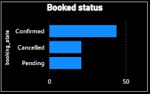
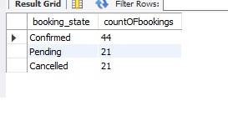
Find the count of booking status.
select booking_state , count(booking_state) as countOFbookings from bookings group by 1;

Slide 19

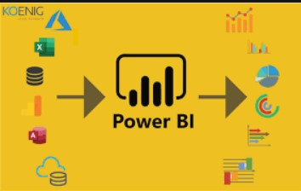
POWERBI DASHBOARD
Link to the dashboard

Slide 20
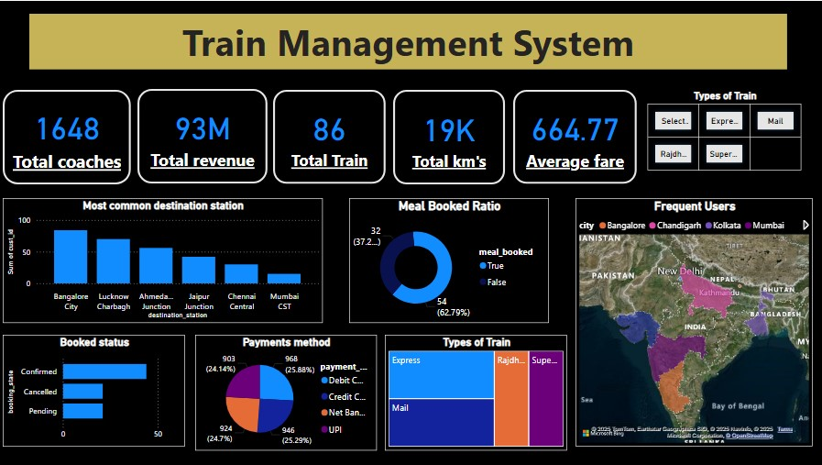

Slide 21
Story Telling
Efficient information flow is as crucial as the smooth movement of trains in railway management. This project, the Train Management System, is a significant step towards that goal. By using SQL and PowerBI, we've transformed raw data into actionable insights.
We began by constructing a database with SQL, carefully organizing information about customers, bookings, and station details. This structured foundation allowed us to move beyond simple record-keeping, enabling us to trace the connections between passengers and their journeys . Then, we used PowerBI to bring this data into life
Seeing the most popular routes at a glance to optimize schedules and resource
allocation.
Quickly accessing view of a passenger's journey to resolve queries with speed and accuracy.
Identifying trends in booking patterns to inform decisions about expansion and service improvements.
This project demonstrates the transformative power of data when combined with the right tools. By connecting SQL to PowerBI, we've built a platform for continuous improvement and innovation in railway operations.

Slide 22
Recommendations
The groundwork has been laid for future enhancements, such as:
AI-Powered Disruption Management and Alternative Routing.
Personalized Travel Packages and Bundles.
Predictive analytics for proactive maintenance.
Expand Data Sources
Enhance User Interface
Strengthen Security Measures
Personalized Recommendations
Automated Customer Support
Dynamic Pricing

Slide 23
conclusion
This Train Management System represents a significant advancement in railway operations, transforming raw data into actionable insights through the combined power of SQL and PowerBI .
This structured approach establishes a reliable framework for analyzing the complex relationships between passengers, journeys, and destinations. Furthermore, the system is designed for future growth and innovation.
By integrating cutting-edge technologies like AI-powered disruption management and personalized travel packages, the system can continue to evolve and meet the ever-changing demands of the transportation industry.
This Train Management System is more than just a technological solution; it is a platform for continuous improvement and innovation in railway operations

Slide 24
THANK YOU

